Slide 1










ATAI
Advanced Technique of Artificial Intelligence
ATAI
ChongqingUniversity _{AdvancedTechniqueof}
of Technology Artificial Intelligence
Chongqing University of
Technology
Chongqing University ^{ATAI}
_{of Technology} Advanced Techniqueof
Artificial Intelligence
Chongqing University of Technology
Chongqing University of Technology
Multi-granularity Intent Modeling with Adversarial Robustness for Sequential Recommendation
—AAAI 2026
Reported by Cong Sheng
1

Slide 2
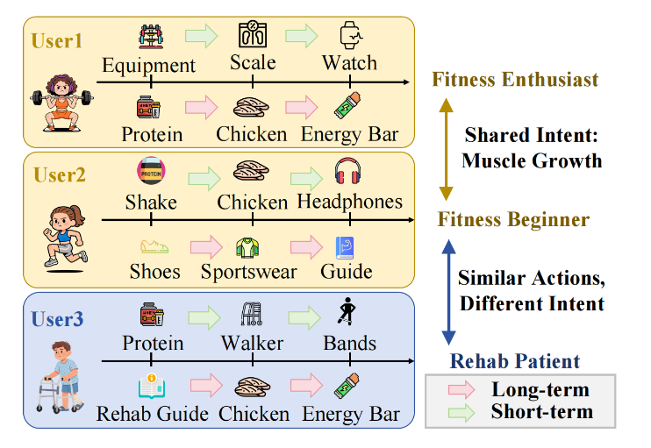
ATAI
Advanced Technique of Artificial Intelligence
ATAI
ChongqingUniversity _{AdvancedTechniqueof}
of Technology Artificial Intelligence
Chongqing University of
Technology
Chongqing University ^{ATAI}
_{of Technology} Advanced Techniqueof
Artificial Intelligence
Chongqing University of Technology
Chongqing University of Technology
Motivation
1) Existing sequential methods often model the whole sequence as a unified block and overlook users’ latent multi-granularity intents
2) Sparse interaction data makes it difficult to infer users’ true intents and behavioral patterns
3) Real-world user sequences inevitably contain noise, requiring more robust recommendation modeling

Slide 3
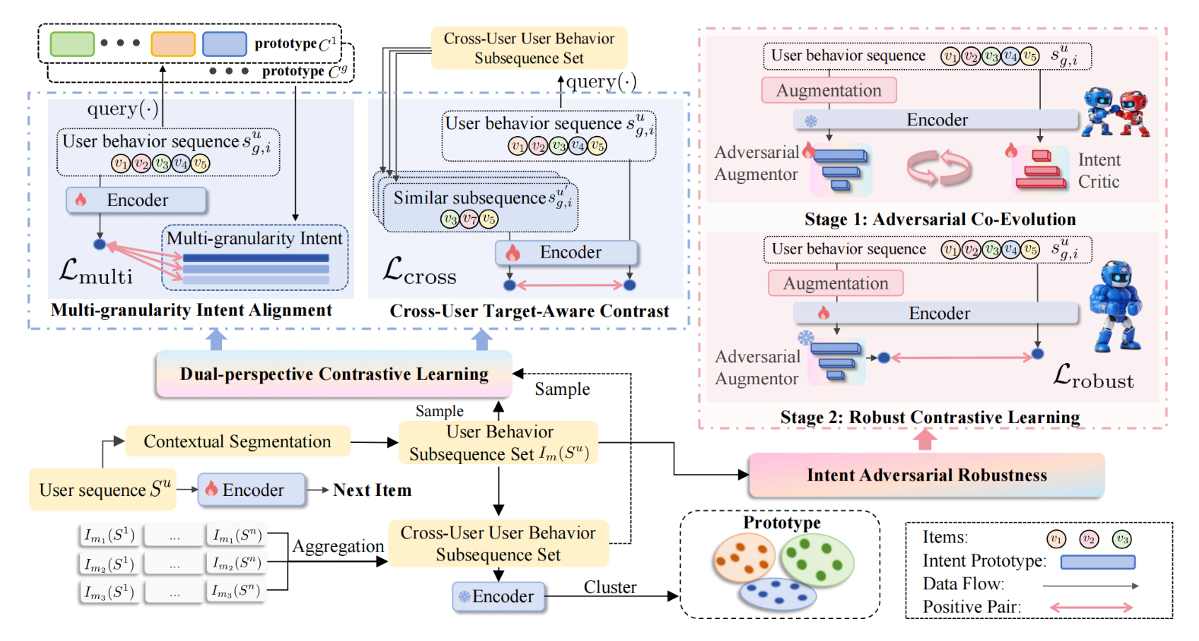
ATAI
Advanced Technique of Artificial Intelligence
ATAI
ChongqingUniversity _{AdvancedTechniqueof}
of Technology Artificial Intelligence
Chongqing University of
Technology
Chongqing University ^{ATAI}
_{of Technology} Advanced Techniqueof
Artificial Intelligence
Chongqing University of Technology
Chongqing University of Technology
Overview

Slide 4
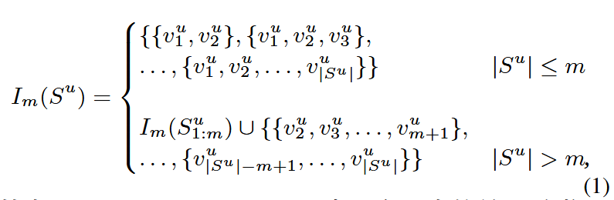
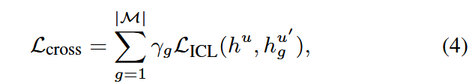

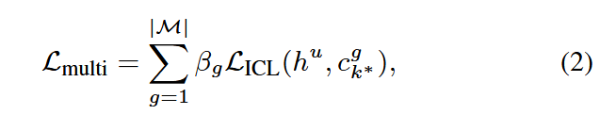
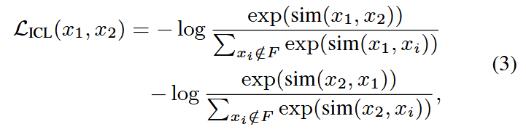
ATAI
Advanced Technique of Artificial Intelligence
ATAI
ChongqingUniversity _{AdvancedTechniqueof}
of Technology Artificial Intelligence
Chongqing University of
Technology
Chongqing University ^{ATAI}
_{of Technology} Advanced Techniqueof
Artificial Intelligence
Chongqing University of Technology
Chongqing University of Technology
Method

Slide 5
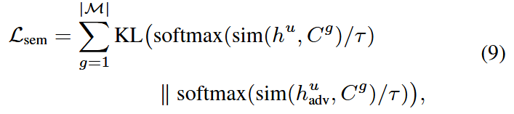

ATAI
Advanced Technique of Artificial Intelligence
ATAI
ChongqingUniversity _{AdvancedTechniqueof}
of Technology Artificial Intelligence
Chongqing University of
Technology
Chongqing University ^{ATAI}
_{of Technology} Advanced Techniqueof
Artificial Intelligence
Chongqing University of Technology
Chongqing University of Technology
Method

Slide 6
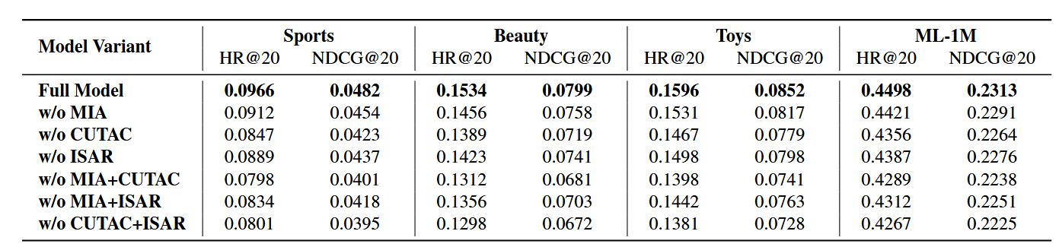
ATAI
Advanced Technique of Artificial Intelligence
ATAI
ChongqingUniversity _{AdvancedTechniqueof}
of Technology Artificial Intelligence
Chongqing University of
Technology
Chongqing University ^{ATAI}
_{of Technology} Advanced Techniqueof
Artificial Intelligence
Chongqing University of Technology
Chongqing University of Technology
Experiments

Slide 7
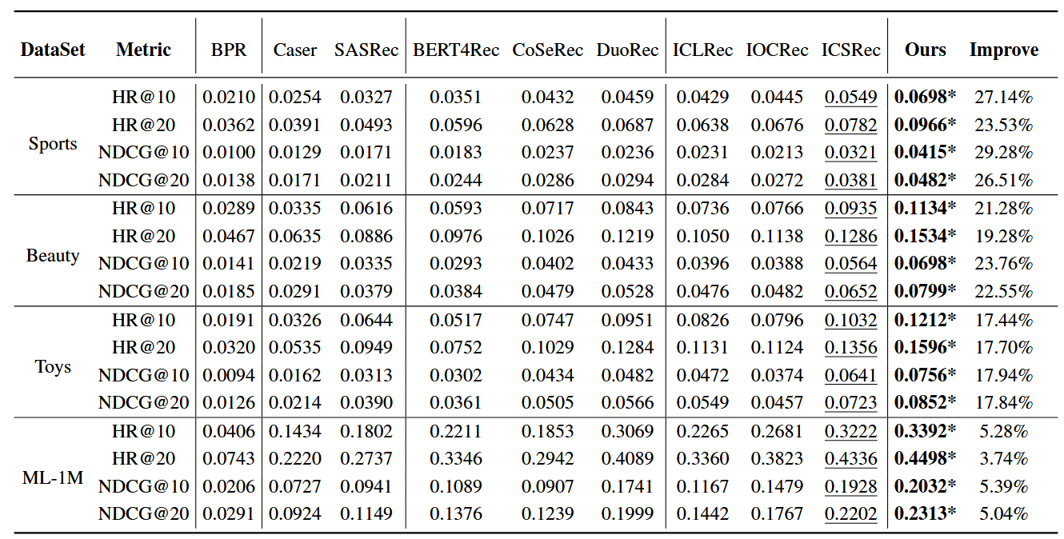
ATAI
Advanced Technique of Artificial Intelligence
ATAI
ChongqingUniversity _{AdvancedTechniqueof}
of Technology Artificial Intelligence
Chongqing University of
Technology
Chongqing University ^{ATAI}
_{of Technology} Advanced Techniqueof
Artificial Intelligence
Chongqing University of Technology
Chongqing University of Technology
Experiments

Slide 8
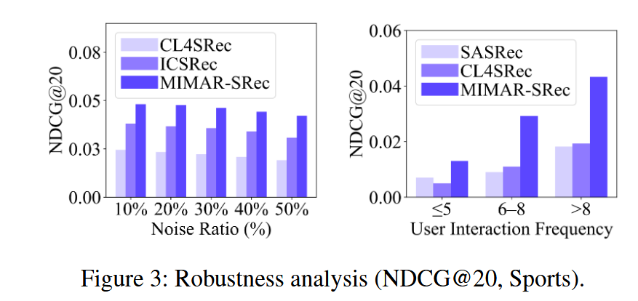
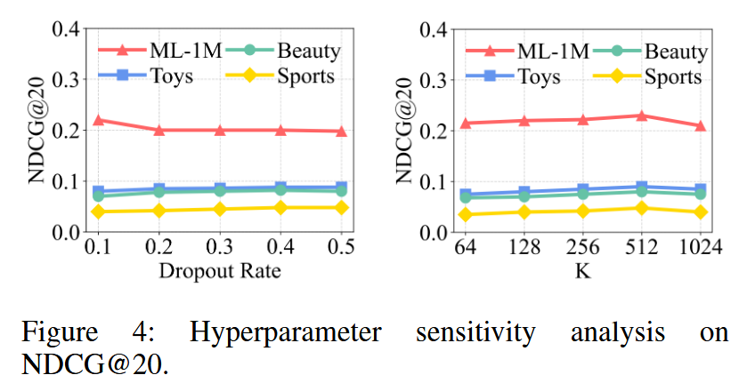
ATAI
Advanced Technique of Artificial Intelligence
ATAI
ChongqingUniversity _{AdvancedTechniqueof}
of Technology Artificial Intelligence
Chongqing University of
Technology
Chongqing University ^{ATAI}
_{of Technology} Advanced Techniqueof
Artificial Intelligence
Chongqing University of Technology
Chongqing University of Technology
Experiments

Slide 9


ATAI
Advanced Technique of Artificial Intelligence
ATAI
ChongqingUniversity _{AdvancedTechniqueof}
of Technology Artificial Intelligence
Chongqing University of
Technology
Chongqing University ^{ATAI}
_{of Technology} Advanced Techniqueof
Artificial Intelligence
Chongqing University of Technology
Chongqing University of Technology
Thanks!

